Slide 1
Full Custom IC
One Chip Design
Harman Semicon. Arcademy 6기
Kim Min Ji

Slide 2
Contents
01
02
03
Program & Tool
Digital Logic Gates
Digital Circuit
Not
NAND
Nor
MUX
Adder
Universal Shift Register
04
05
06
Analog Circuit
One Chip
Review
Common Source Amp
Differential Amp

Slide 3

Part 1
Program & Tool

Slide 4


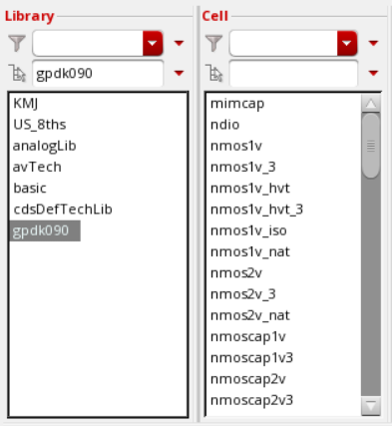
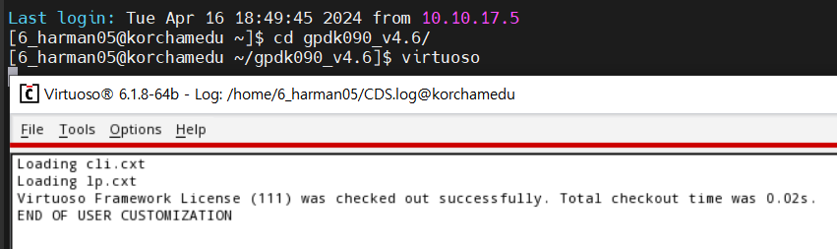
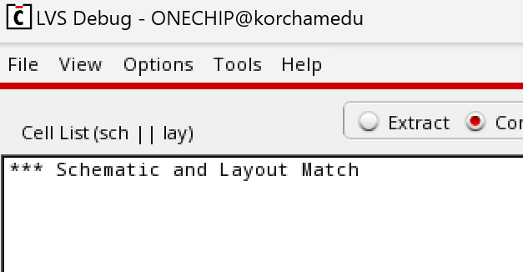
Part 1 >>
Program & Tool
Cadence Virtuoso
Assura
Library
■ Schematic Editor
■ Layout Editor
■ Specture / ADE
■ DRC
■ LVS
■ gpdk_090

Slide 5
Part 2
Digital Logic Gates

Slide 6
{ }
Digital Logic Gates
NOT
NAND
2NAND
3NAND
4NAND
NOR
- 2NOR
- 3NOR
- 4NOR

Slide 7
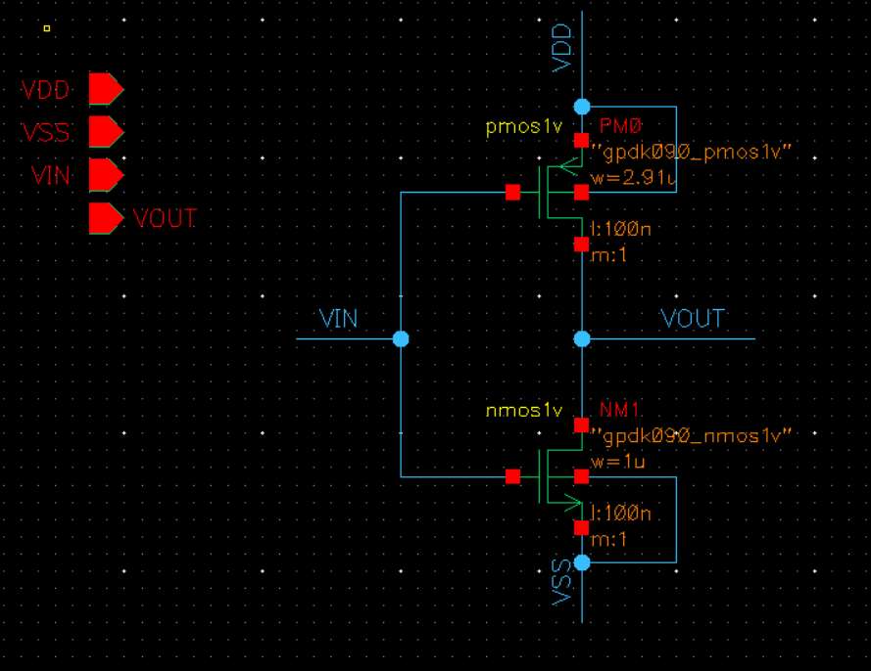
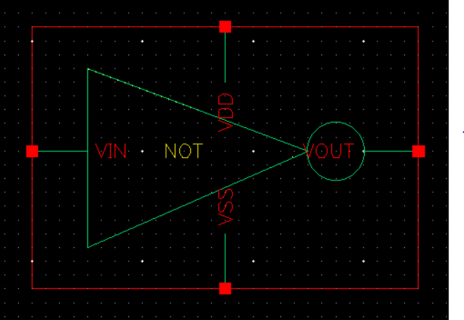
Part 2 >>
NOT
Schematic
Symbol

Slide 8
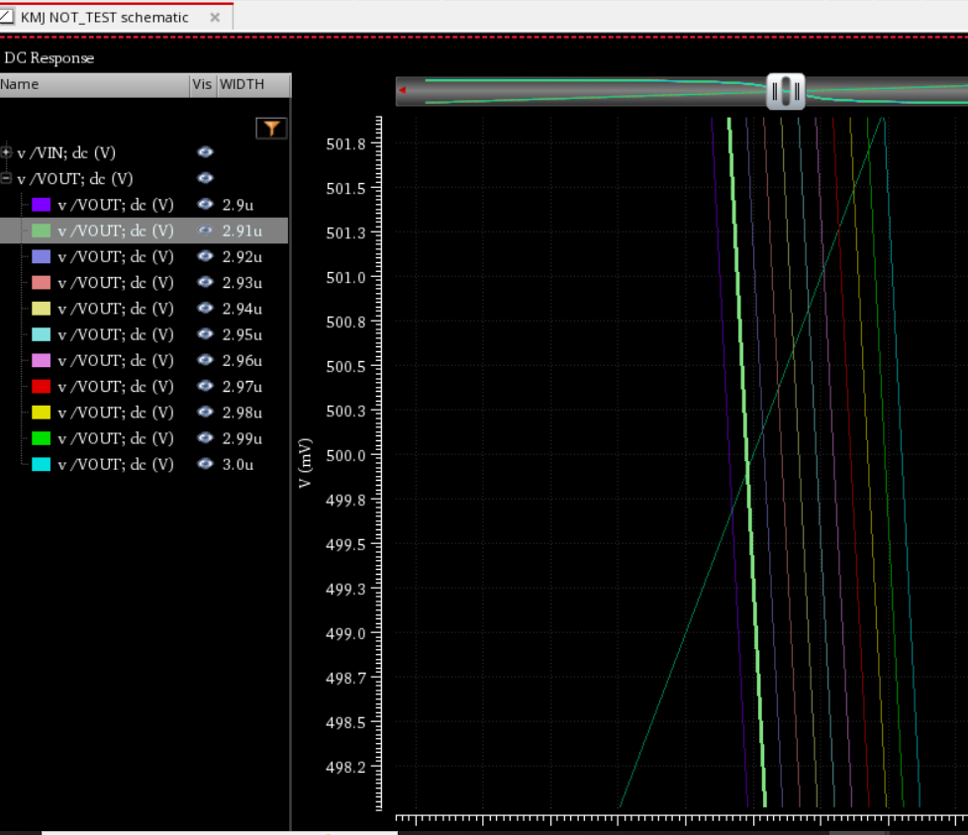
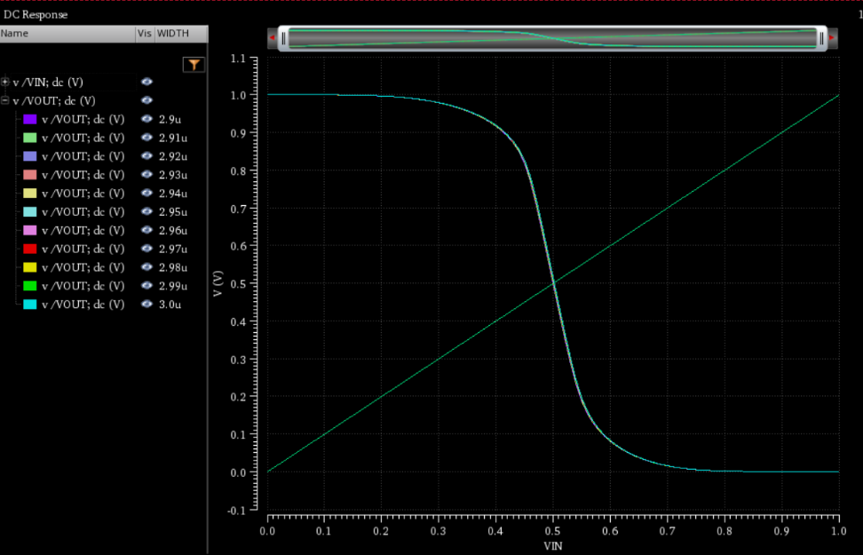
Part 2 >>
NOT Simulation
P MOS Width : 2.91μ

Slide 9
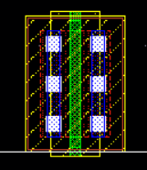
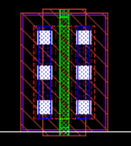
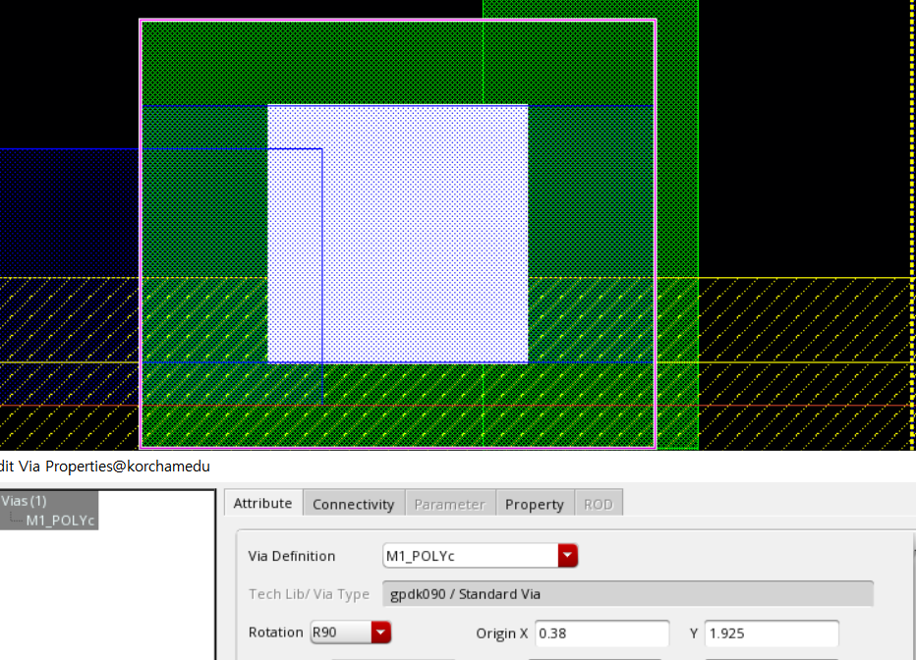
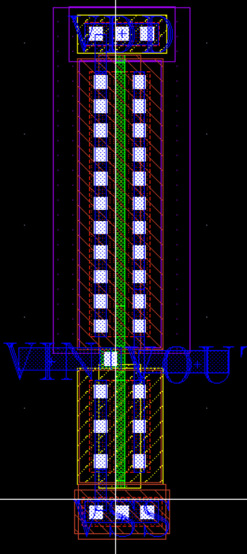
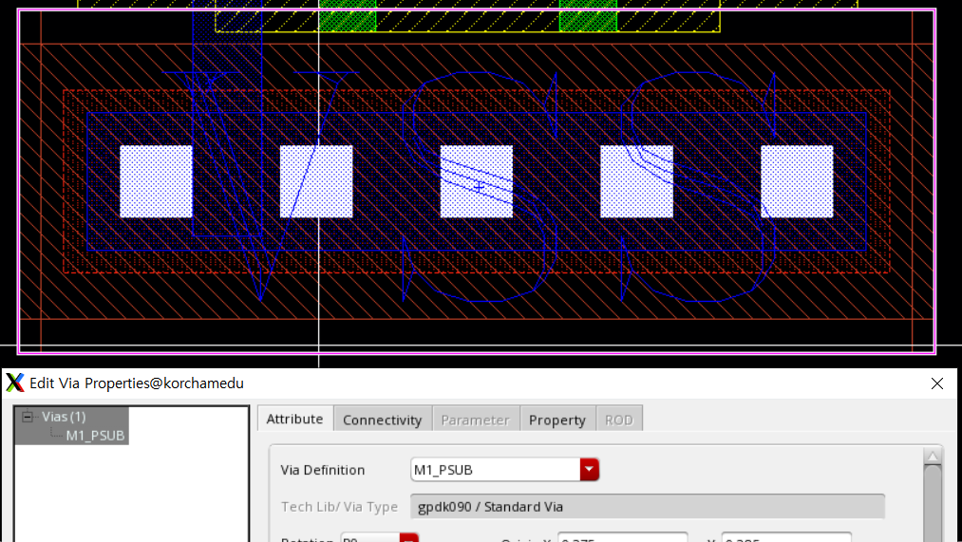
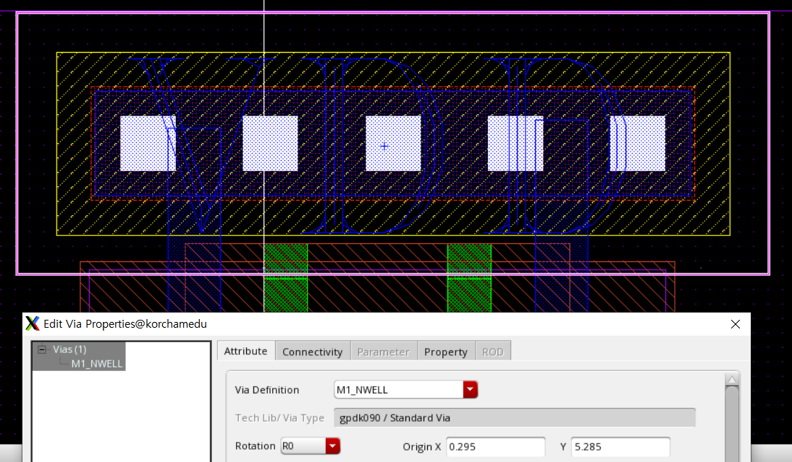
Part 2 >>
NOT Layout
N MOS
P MOS
M1_POLYc
NOT Layout
M1_PSUEB
M1_NWell

Slide 10
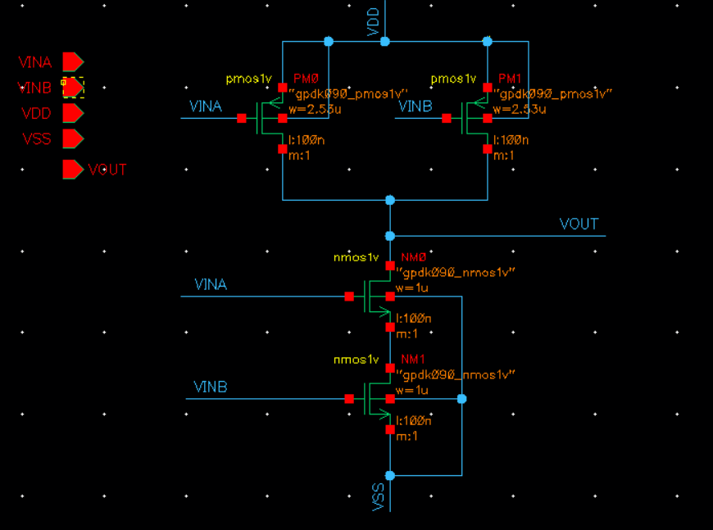
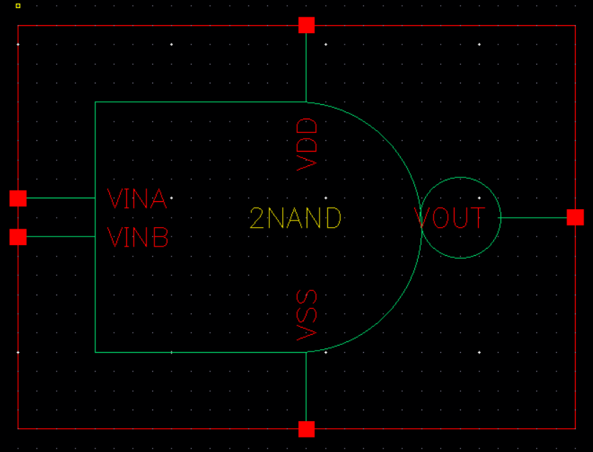
Part 2 >>
2NAND
Schematic
Symbol

Slide 11
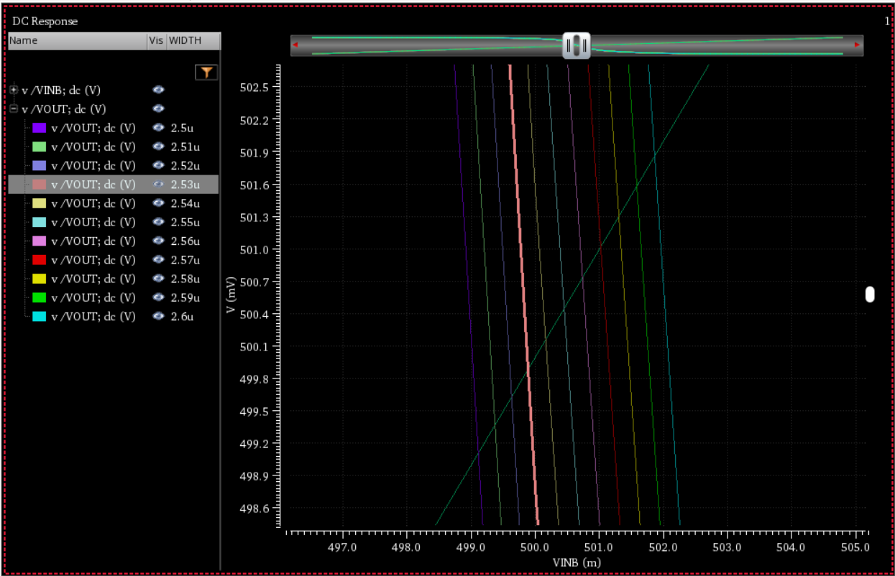
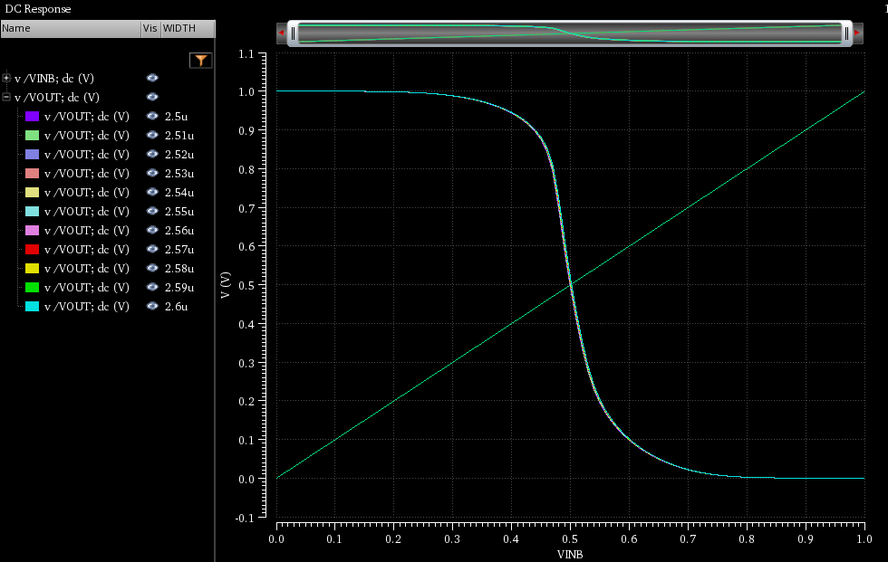
Part 2 >>
2NAND Simulation
P MOS Width : 2.53μ

Slide 12
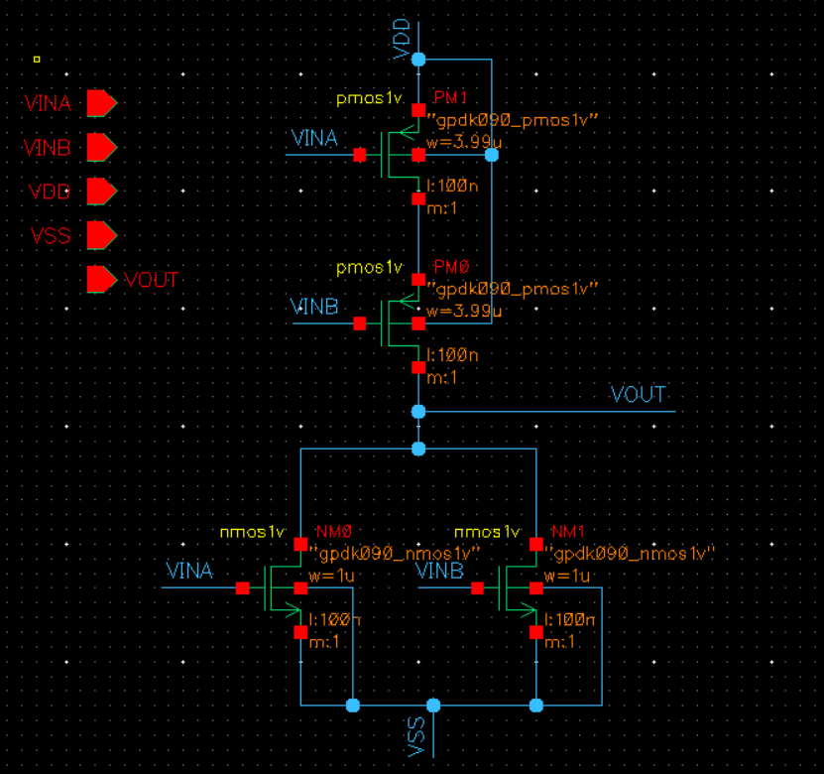
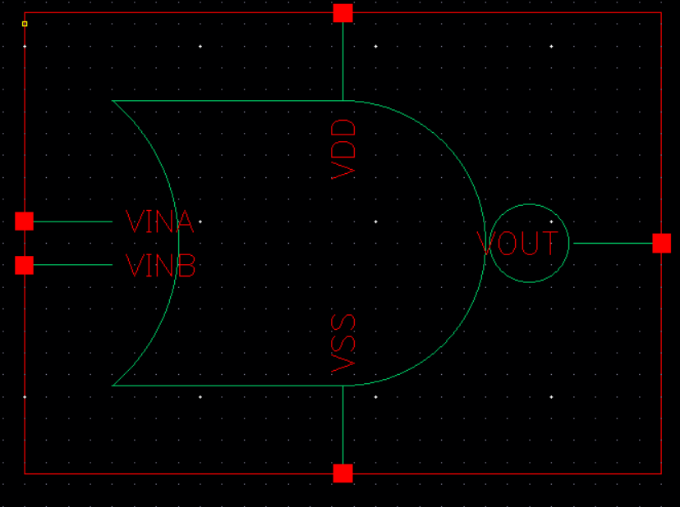
Part 2 >>
2NOR
Schematic
Symbol

Slide 13
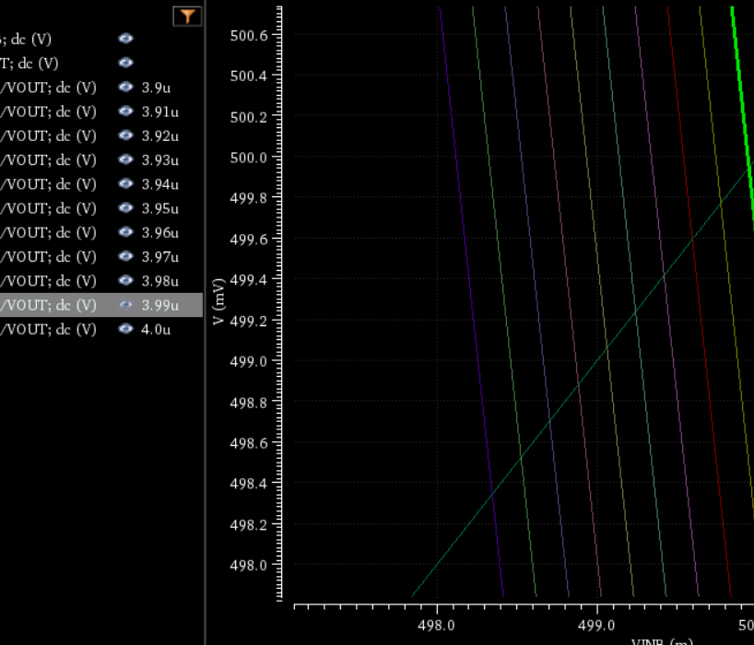

Part 2 >>
2NOR Simulation
P MOS Width : 3.99μ

Slide 14
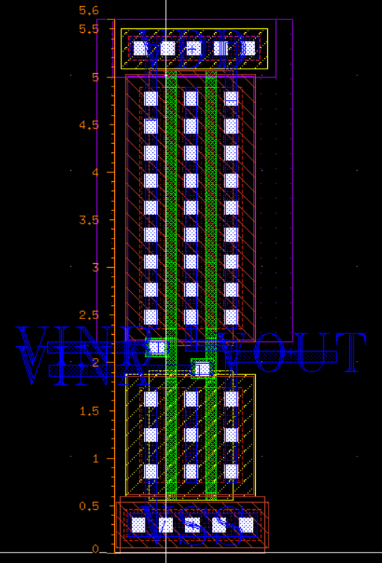
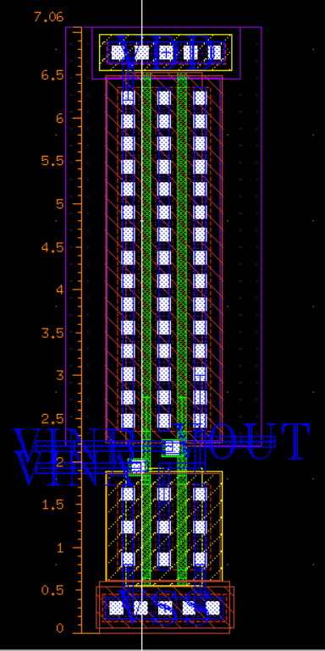
Part 2 >>
2NAND & 2NOR Layout
5.6μm
7.06μm
2NAND
2NOR

Slide 15
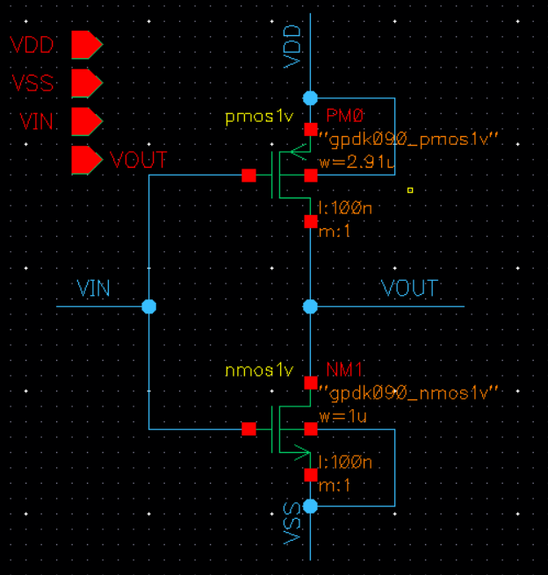
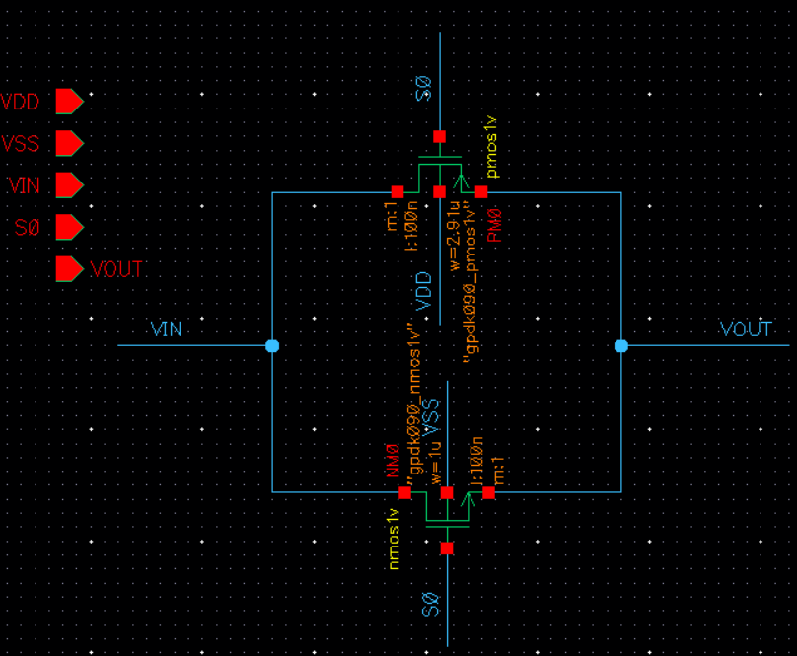
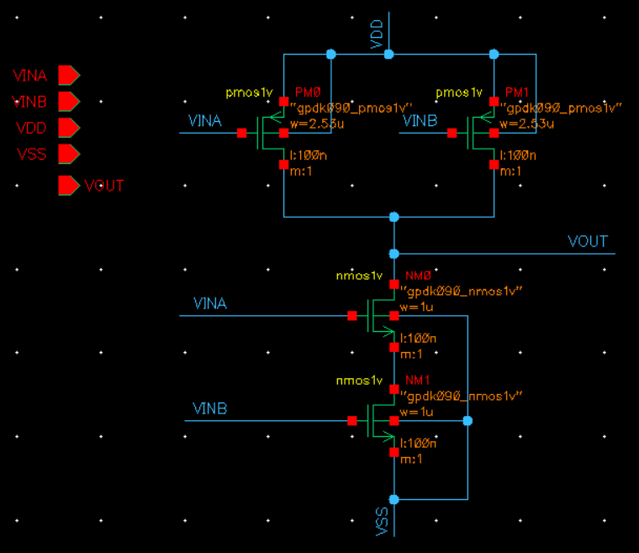
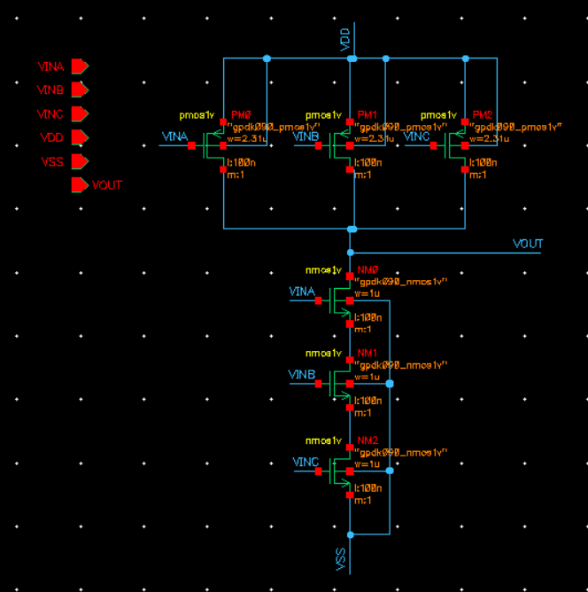
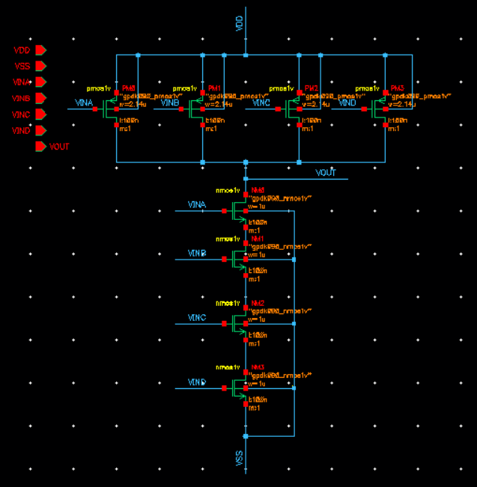
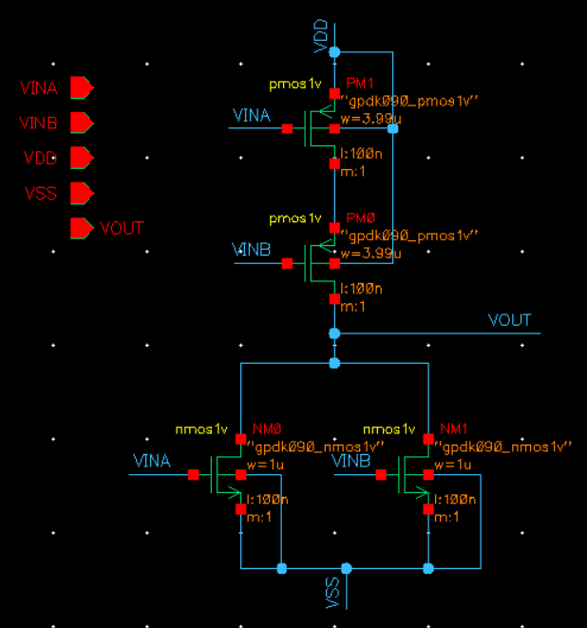
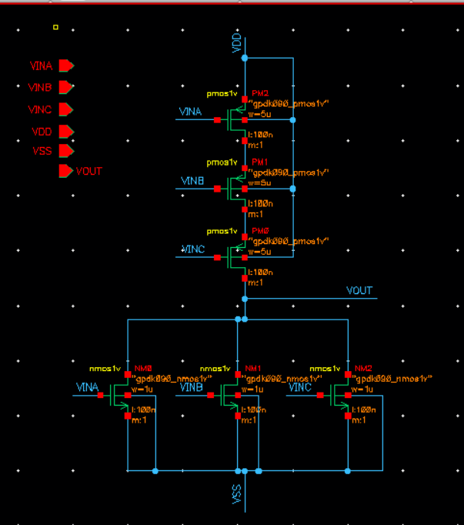
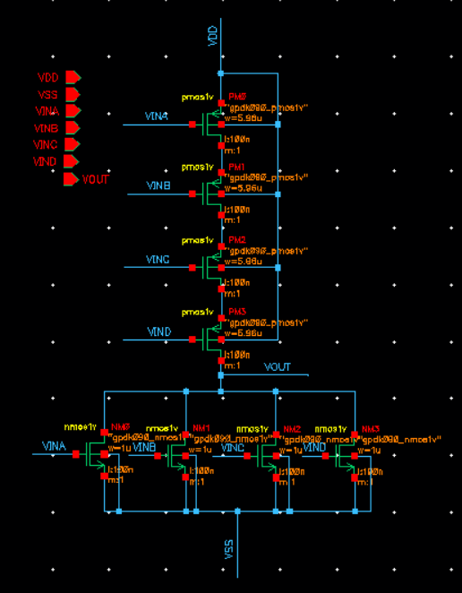
Part 2 >>
Digital Logic Gate Schematic
 | NOT | SWITCH | 2NAND | 3NAND | 4NAND | 2NOR | 3NOR | 4NOR
NMOS L = 100nm | 1μm | 1μm | 1μm | 1μm | 1μm | 1μm | 1μm | 1μm
PMOS L = 100nm | 2.91μm | 2.91μm | 2.53μm | 2.31μm | 2.14μm | 3.99μm | 5μm | 5.96μm
NOT
Switch
2NAND
3NAND
4NAND
2NOR
3NOR
4NOR

Slide 16
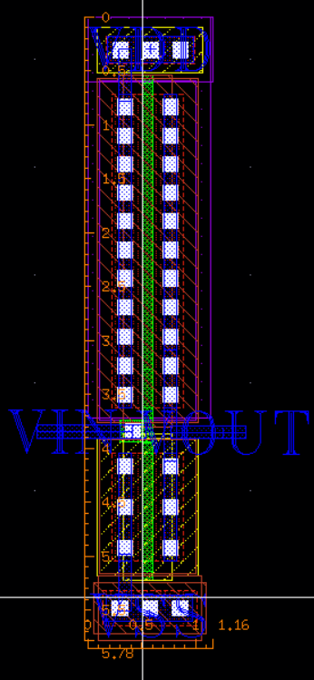
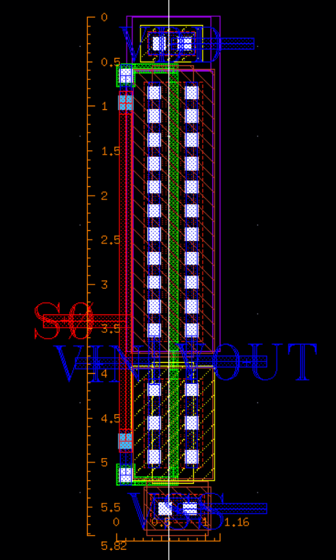
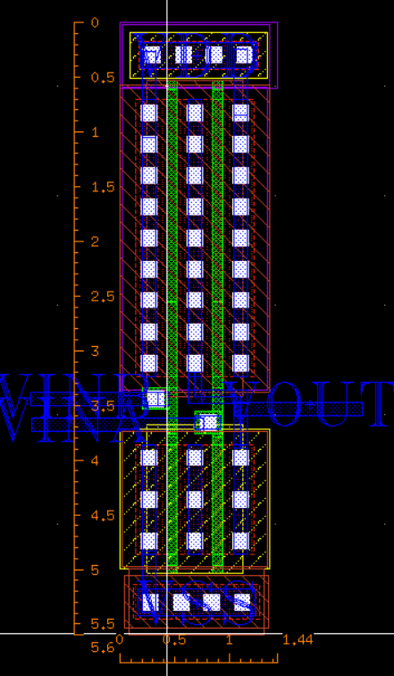
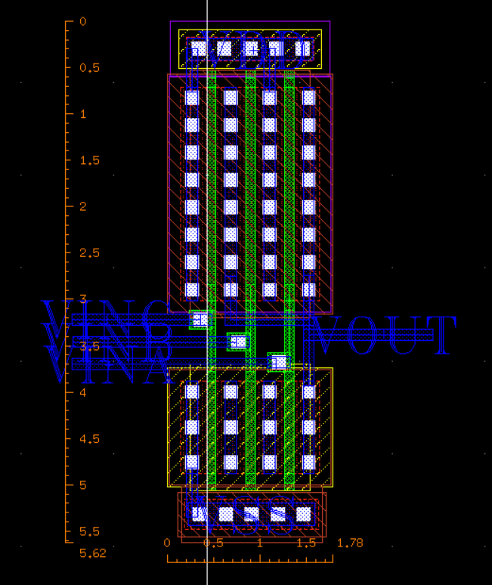
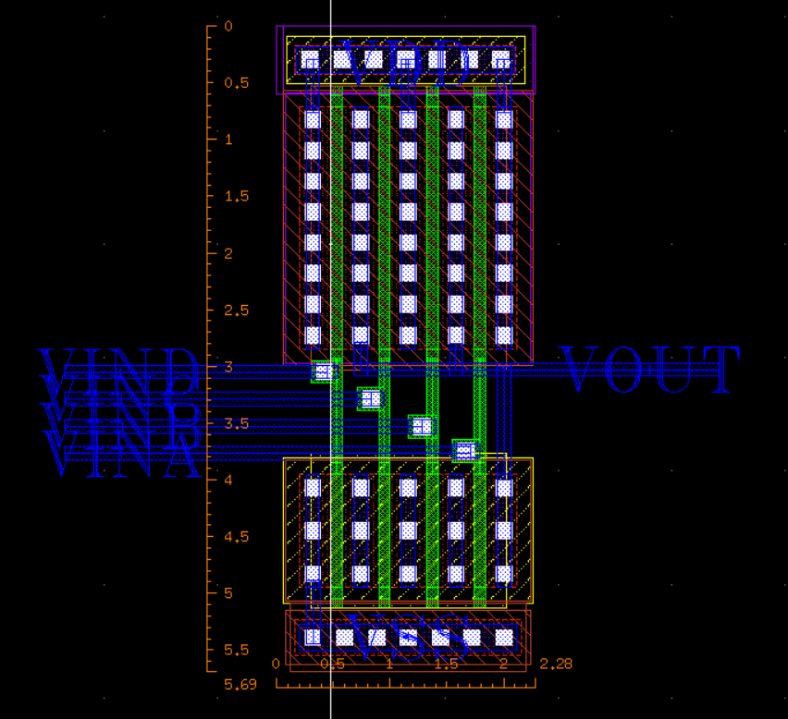
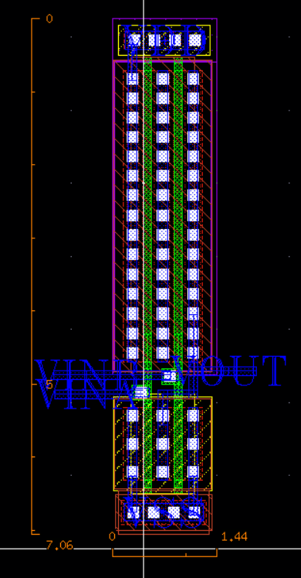
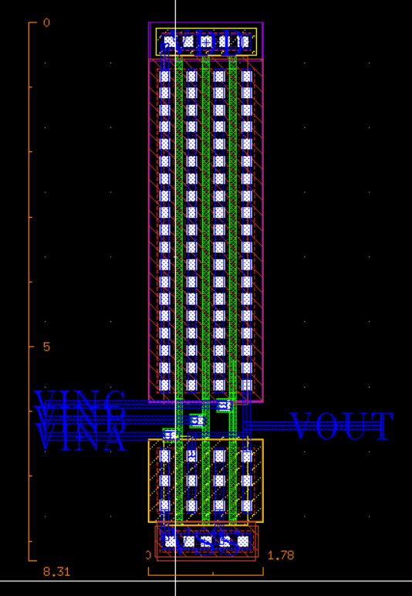
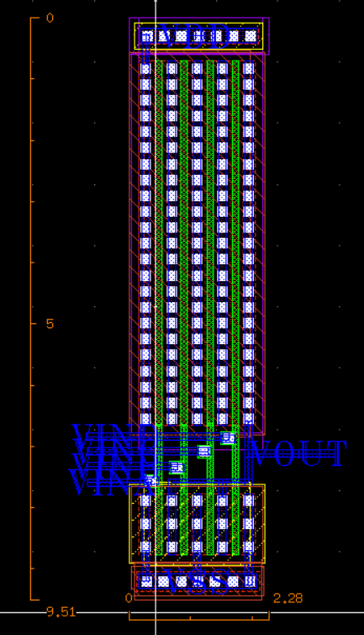
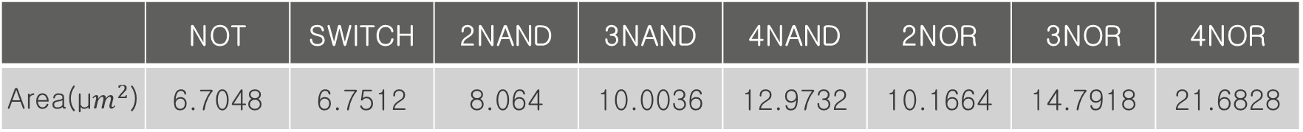
Part 2 >>
Digital Logic Gate Layout
 | NOT | SWITCH | 2NAND | 3NAND | 4NAND | 2NOR | 3NOR | 4NOR
Area(μ$m^{2}$) | 6.7048 | 6.7512 | 8.064 | 10.0036 | 12.9732 | 10.1664 | 14.7918 | 21.6828
NOT
Switch
2NAND
3NAND
4NAND
2NOR
3NOR
4NOR

Slide 17
Part 3
Digital Circuit

Slide 18
{ }
Digital Circuit
MUX
(Difference Logic & Switch)
2x1 MUX
4x1 MUX
8x1 MUX
16x1 MUX
Adder
- Half Adder
Full Adder
4Bit Adder
4Bit Subtractor
Universal
Shift
Register

Slide 19
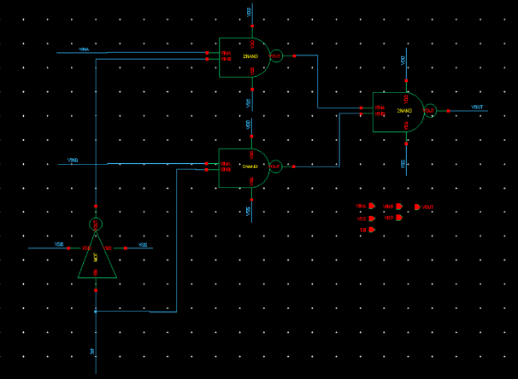
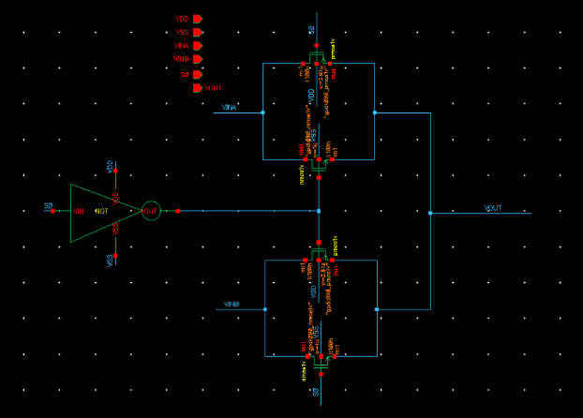
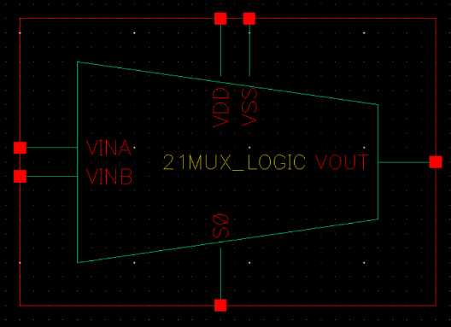
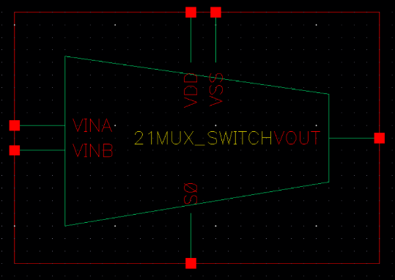
Part 3 >>
2X1 MUX (Logic & Switch)
Schematic
Schematic
Symbol
Symbol
Logic
Switch

Slide 20
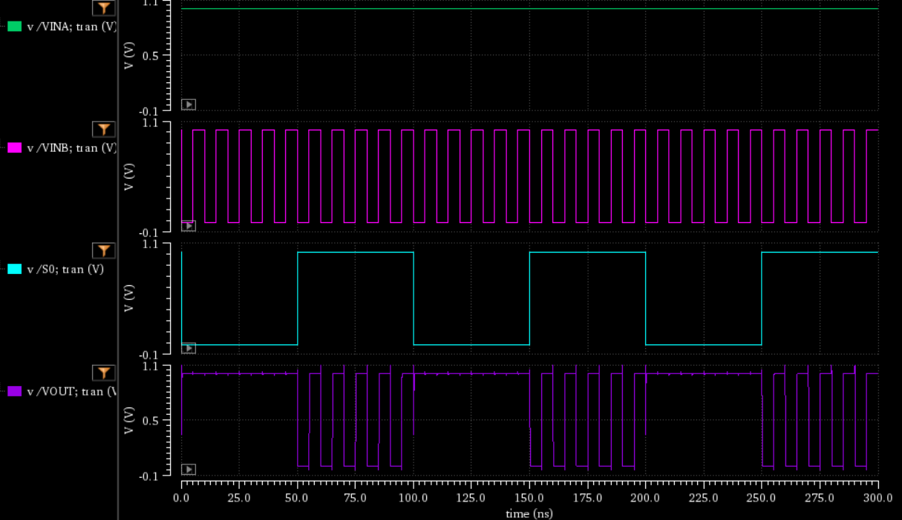
Part 3 >>
2X1 MUX (Logic & Switch) Simulation
S0 | Vout
0 | VINA
1 | VINB

Slide 21
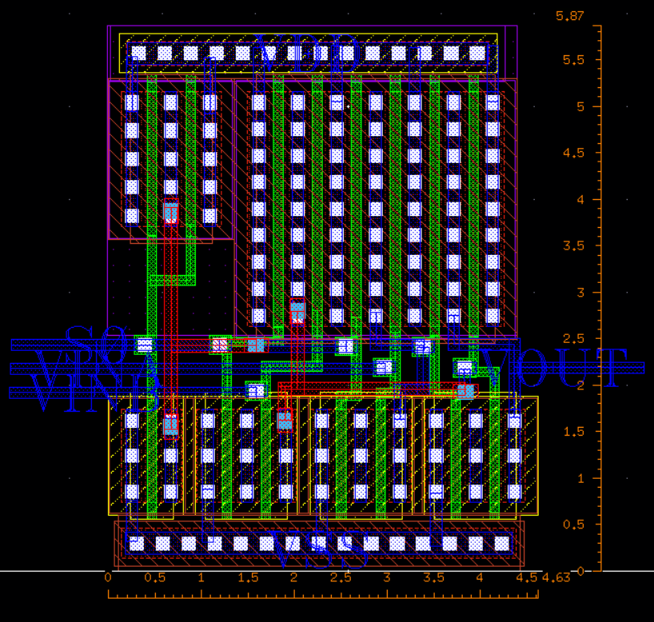
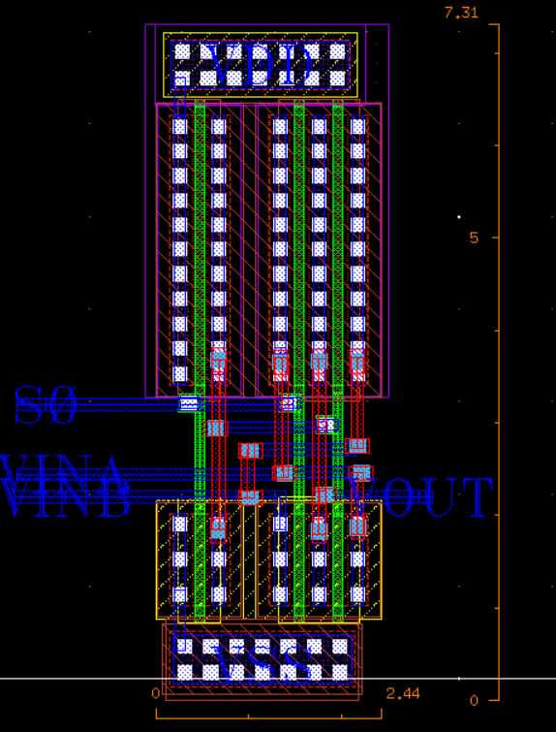
Part 3 >>
2X1 MUX (Logic & Switch) Layout
Logic
Switch
length : 4.63μm , Width : 5.87μm
length : 2.44μm , Width : 7.31μm

Slide 22
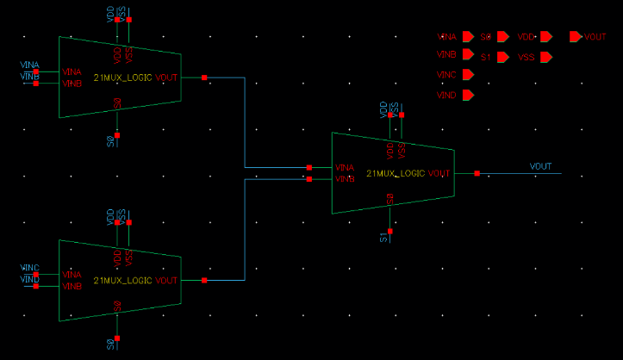
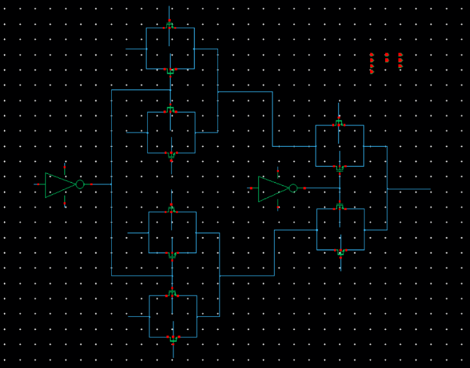
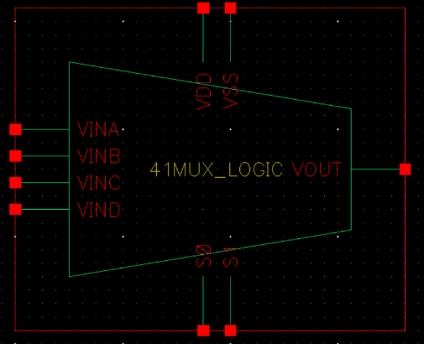
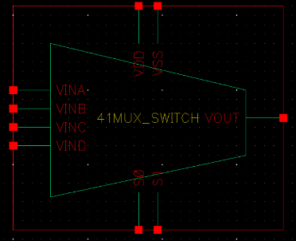
Part 3 >>
4X1 MUX (Logic & Switch)
Schematic
Schematic
Symbol
Symbol
Logic
Switch

Slide 23

Part 3 >>
4X1 MUX (Logic & Switch) Simulation
S1 | S0 | Vout
0 | 0 | VINA
0 | 1 | VINB
1 | 0 | VINC
1 | 1 | VIND
A
B
C
D
A
B
C
D

Slide 24


Part 3 >>
4X1 MUX (Logic & Switch) Layout
Logic
length : 13.63μm , Width : 7.4μm
Switch
length : 6.52μm , Width : 8.04μm

Slide 25


Part 3 >>
8X1 MUX (Logic & Switch)
Schematic
Logic
Schematic
Switch

Slide 26


Part 3 >>
8X1 MUX (Logic & Switch) Simulation
S2 | S1 | S0 | Vout
0 | 0 | 0 | VINA
0 | 0 | 1 | VINB
0 | 1 | 0 | VINC
0 | 1 | 1 | VIND
1 | 0 | 0 | VINE
1 | 0 | 1 | VINF
1 | 1 | 0 | VING
1 | 1 | 1 | VINH
A
B
C
D
E
F
G
H
A
B
C
D
E
F
G
H

Slide 27


Part 3 >>
8X1 MUX (Logic & Switch) Layout
Logic
length : 31.63μm, Width : 8.62μm
Switch
length : 13.6μm, Width : 9.85μm

Slide 28


Part 3 >>
16X1 MUX (Logic & Switch)
Schematic
Logic
Schematic
Switch

Slide 29


Part 3 >>
16X1 MUX (Logic & Switch) Simulation
S3 | S2 | S1 | S0 | Vout
0 | 0 | 0 | 0 | VINA
0 | 0 | 0 | 1 | VINB
0 | 0 | 1 | 0 | VINC
0 | 0 | 1 | 1 | VIND
0 | 1 | 0 | 0 | VINE
0 | 1 | 0 | 1 | VINF
0 | 1 | 1 | 0 | VING
0 | 1 | 1 | 1 | VINH
A
B
C
D
E
F
G
H
S0
S1
S2
S3
A
B
C
D
E
F
G
H

Slide 30


Part 3 >>
16X1 MUX (Logic & Switch) Simulation
S3 | S2 | S1 | S0 | Vout
1 | 0 | 0 | 0 | VINI
1 | 0 | 0 | 1 | VINJ
1 | 0 | 1 | 0 | VINK
1 | 0 | 1 | 1 | VINL
1 | 1 | 0 | 0 | VINM
1 | 1 | 0 | 1 | VINN
1 | 1 | 1 | 0 | VINO
1 | 1 | 1 | 1 | VINP
I
J
K
L
M
N
O
P
S0
S1
S2
S3
I
J
K
L
M
N
O
P

Slide 31


Part 3 >>
16X1 MUX (Logic & Switch) Layout
Logic
length: 67.63μm, Width: 10.815 μm
Switch
length : 26.68μm, Width: 12.84μm

Slide 32






Part 3 >>
16X1 MUX (Logic & Switch) DRC
Logic
Switch

Slide 33






Part 3 >>
16X1 MUX (Logic & Switch) LVS
Logic
Switch

Slide 34

Part 3 >>
MUX(Logic & Switch)
Area | 2x1 MUX | 4x1 MUX | 8x1 MUX | 16x1 MUX
Logic(${\text{μ}\text{m}}^{2}$) | 27.1781 | 100.862 | 272.6506 | 731.41845
Switch(${\text{μ}\text{m}}^{2}$) | 17.8364 | 52.4208 | 133.96 | 342.5712
Ratio | 1.1874 | 1.9240 | 2.0351 | 2.1351
TR | 2x1 MUX | 4x1 MUX | 8x1 MUX | 16x1 MUX
Logic(unit) | 14 | 42 | 98 | 210
Switch(unit) | 6 | 16 | 34 | 68

Slide 35


Part 3 >>
Half Adder
Schematic
Symbol

Slide 36

Part 3 >>
Half Adder Simulation
A
A | B | S | C
0 | 0 | 0 | 0
0 | 1 | 1 | 0
1 | 0 | 1 | 0
1 | 1 | 0 | 1
B
S
C

Slide 37


Part 3 >>
Full Adder
Schematic
Symbol

Slide 38

Part 3 >>
Full Adder Simulation
A
A | B | Cin | Sum | Cout
0 | 0 | 0 | 0 | 0
0 | 0 | 1 | 1 | 0
0 | 1 | 0 | 1 | 0
0 | 1 | 1 | 0 | 1
1 | 0 | 0 | 1 | 0
1 | 0 | 1 | 0 | 1
1 | 1 | 0 | 0 | 1
1 | 1 | 1 | 1 | 1
B
CIN
S
COUT

Slide 39


Part 3 >>
Half Adder & Full Adder Layout
Full Adder
Half Adder
length : 11.11 μm, Width : 7.61μm
length : 4.6 μm, Width : 6.49μm

Slide 40


Part 3 >>
4Bit Adder
Schematic
Symbol

Slide 41


Part 3 >>
4Bit Adder Simulation
A
1
1
C
1
1
E
1
1
G
1
1
B
0
1
0000(0) + 0000(0) = 0 0000(0)
1111(15) + 0000(0) = 0 1111(15)
0000(0) + 1111(15) = 0 1111(15)
1111(15) + 1111(15) = 1 1110(30)
D
0
1
F
0
1
H
0
1
S0
1
0
S1
1
1
S2
1
1
S3
1
1
COUT
0
1

Slide 42


Part 3 >>
4Bit Subtractor
Schematic
Symbol

Slide 43


Part 3 >>
4Bit Subtractor Simulation
SIGN: 0 ← Adder
0000(0) + 0000(0) = 0 0000(0)
1111(15) + 0000(0) = 0 1111(15)
0000(0) + 1111(15) = 0 1111(15)
1111(15) + 1111(15) = 1 1110(30)
A
C
E
G
B
D
F
H
SIGN: 1 ← Subtractor
0000(0) - 00000(0) = 1 0000(0)
1111(15) - 0000(0) = 1 1111(15)
0000(0) - 1111(15) = 0 1111(-15)
1111(15) - 1111(15) = 1 0000(0)
SIGN
S0
S1
S2
S3
COUT

Slide 44


Part 3 >>
4Bit Adder & 4Bit Subtractor Layout
4Bit Adder
length : 44.05 μm, Width : 9.36μm
4Bit Subtractor
length : 53.77 μm, Width : 9.36μm

Slide 45






Part 3 >>
4Bit Subtractor DRC & LVS
DRC
LVS

Slide 46

Part 3 >>
Universal Shift Register
Out_0
Out_1
Out_2
Out_3
Asynchronos-reset
TGFF
v
4x1 MUX Switch
2x1 MUX Switch
Right Shift
Left Shift
Schematic
Input 0
Input 1
Input 2
Input 3

Slide 47


Part 3 >>
Universal Shift Register Simulation
CLK
LS
RS
Input_0
Input_1
Input_2
Input_3
S1
S1 = 0 S0 = 1
Right Shift (RS)
S1 = 0 S0 = 0
Hold
S0
RST
RST
Out_0
0
Out_1
0
Out_2
0
Out_3
0

Slide 48


Part 3 >>
Universal Shift Register Simulation
CLK
LS
RS
Input_0
0
Input_1
0
Input_2
1
Input_3
0
S1
S1 = 1 S0 = 0
Left Shift (LS)
S1 = 1 S0 = 1
Parallel load
S0
RST
Out_0
0
Out_1
0
RST
Out_2
1
Out_3
0
Out_0
0

Slide 49

Part 3 >>
Universal Shift Register Layout
length : 50.925 μm, Width : 11.72μm

Slide 50




Part 3 >>
Universal Shift Register DRC & LVS
LVS
DRC

Slide 51
Part 4
Analog Circuit

Slide 52
{ }
Analog Circuit
Common Source Amp
Differential Amp

Slide 53




Part 4 >>
Common Source Amp
Simulation
Gain
6.354[dB]
Schematic
CS AMP | Resistor | Nmos0
 | 4kΩ | 1μm

Slide 54





Part 4 >>
Common Source Amp
Layout
DRC & LVS

Slide 55


Part 4 >>
Differential Amp
Schematic
Symbol
Diff AMP | Resistor | Nmos0 | Nmos1 | Nmos2 | Nmos3 | Pmos1 | Pmos2
 | 25kΩ | 2μm | 2μm | 800nm | 800nm | 250nm | 250nm

Slide 56



Part 4 >>
Differential Amp Simulation
Gain
13.32[dB]

Slide 57




Part 4 >>
Differential Amp
Layout
DRC & LVS

Slide 58
Part 5
One Chip

Slide 59


Part 5 >>
One Chip

Slide 60


Part 5 >>
One Chip
Layout
Schematic

Slide 61






Part 5 >>
One Chip
DRC
LVS

Slide 62
Part 6
Review

Slide 63
Part 6 >>
Review
LOW Power
Fast
Cheaper

Slide 64

Fin.

